Slide 1
CS682 Final project presentation

Slide 2
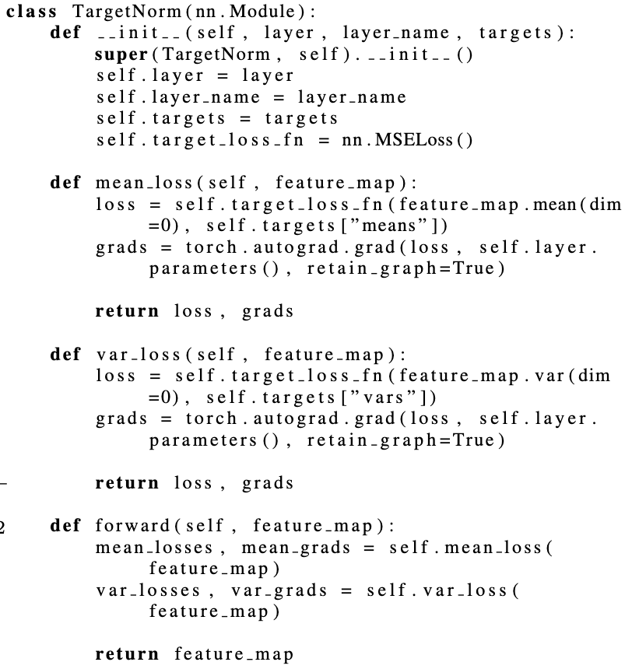
Novel Normalization Approach for Biological Data Analysis
bypassing traditional data normalization to allow neural networks to learn from the true characteristics of the raw data
normalization was reimagined as an active process that self-adjusts during learning
CIFAR-10, Gene Expression, and ECG datasets

Slide 3
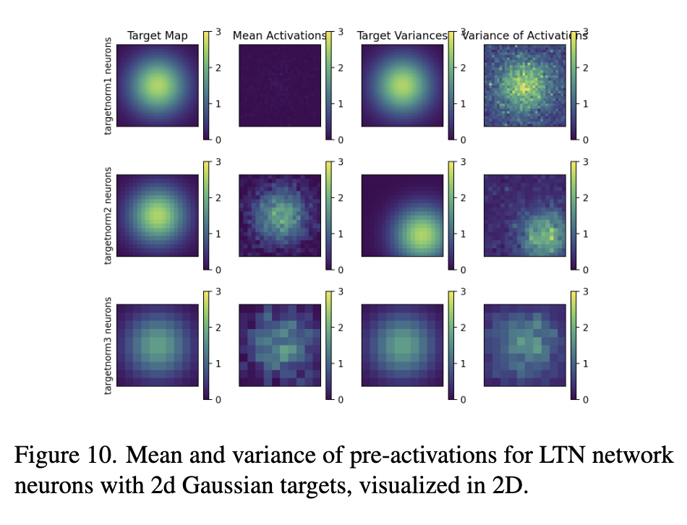
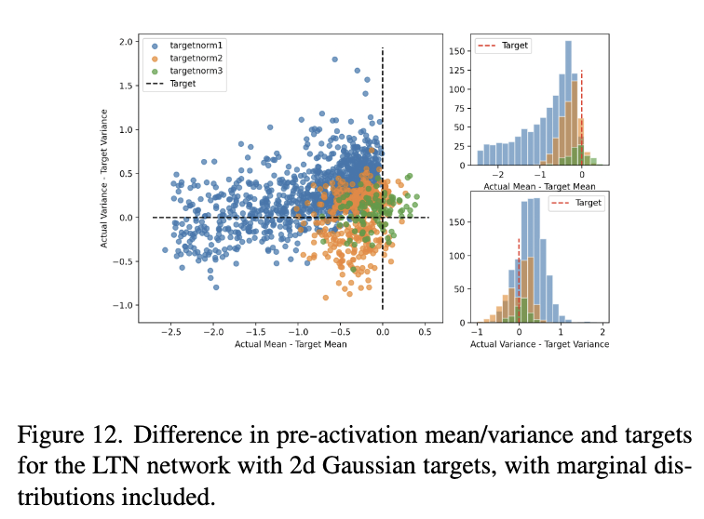
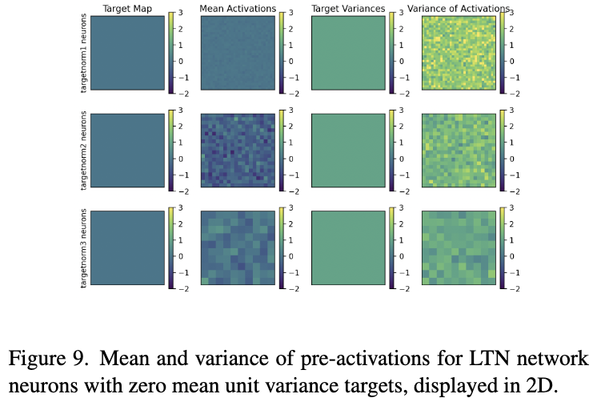
Comparative Analysis of Normalization Methods

Slide 4
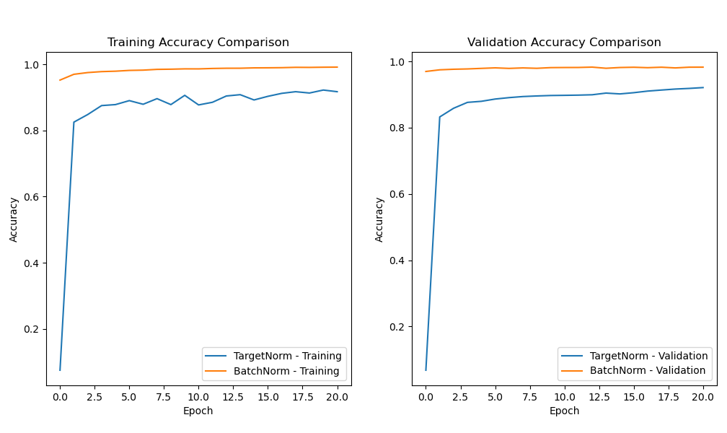
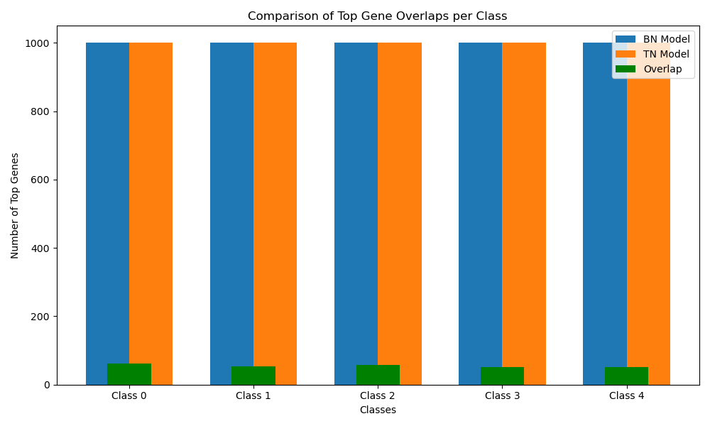
Application on Biological Data

Slide 5
Thank you
Notes:
https://www.nature.com/articles/s41551-022-00991-2

